Slide 1
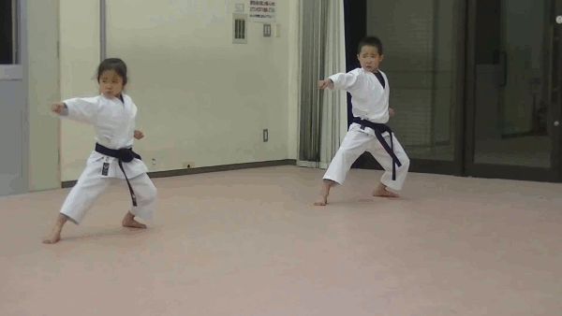
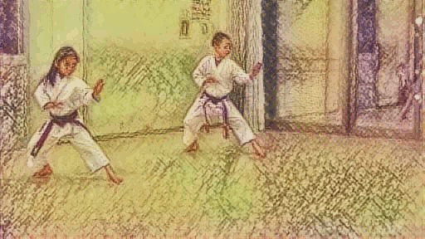
Neural Style Transfer on Video Clips
Team Member:
Tsehao Hsu, Jia Liu, Tue Ngo

Slide 2
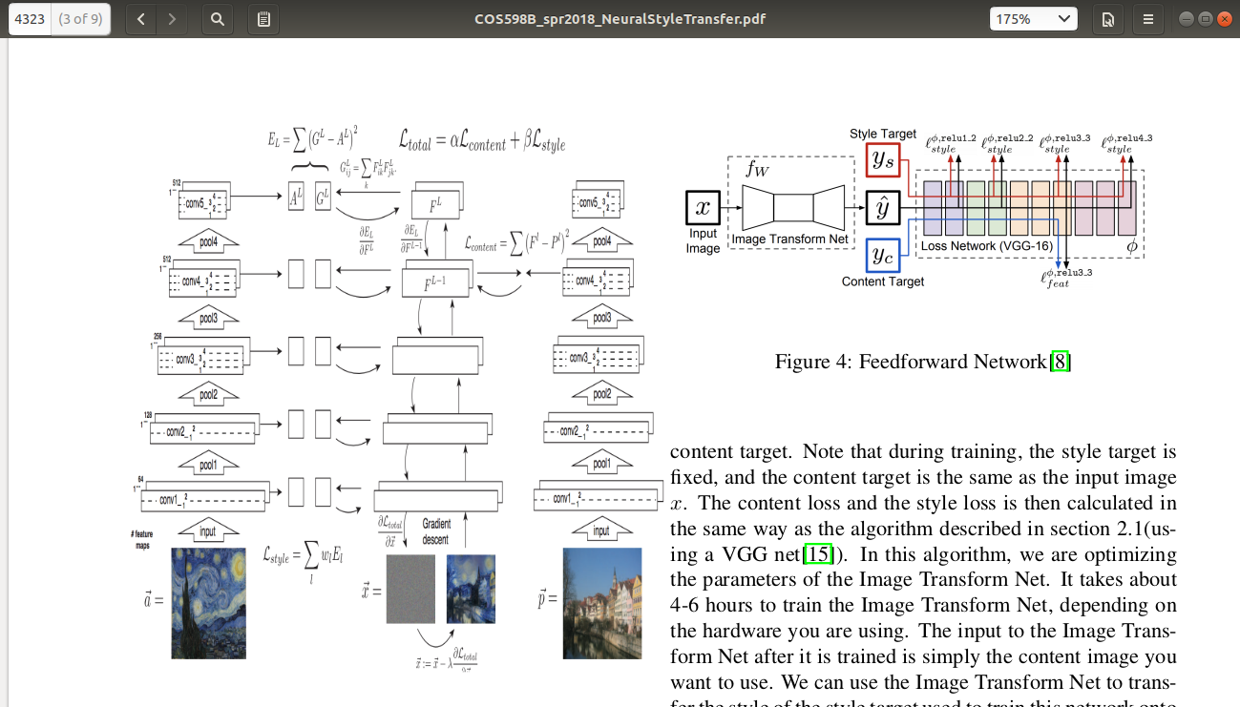
Original Style Transfer Network
L. Gatys et. al.

Slide 3


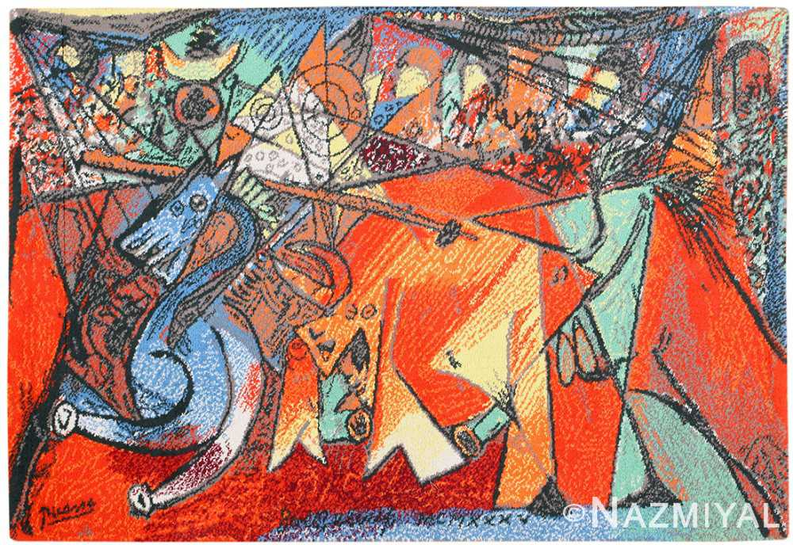
Style Transfer Demo
One frame processed by the original neural style transfer
0-400 iterations
content
style
+
=
It takes about 15 minutes to run 400 iterations and render 1 frame.
Need a faster model to transcribe a video!

Slide 4
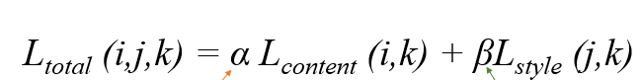
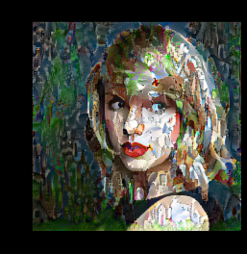


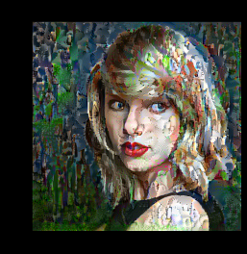
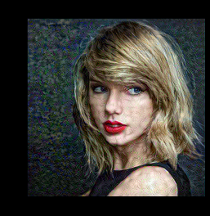
Content/Style Loss Ratio
Neural style transfer with different ratio of alpha(content weight) and beta (style weight)
Varying ratio=alpha/beta
10^10:1
10^5:1
1:1
10^-5:1
10^-10:1
Style weight increases
Content weight increases

Slide 5
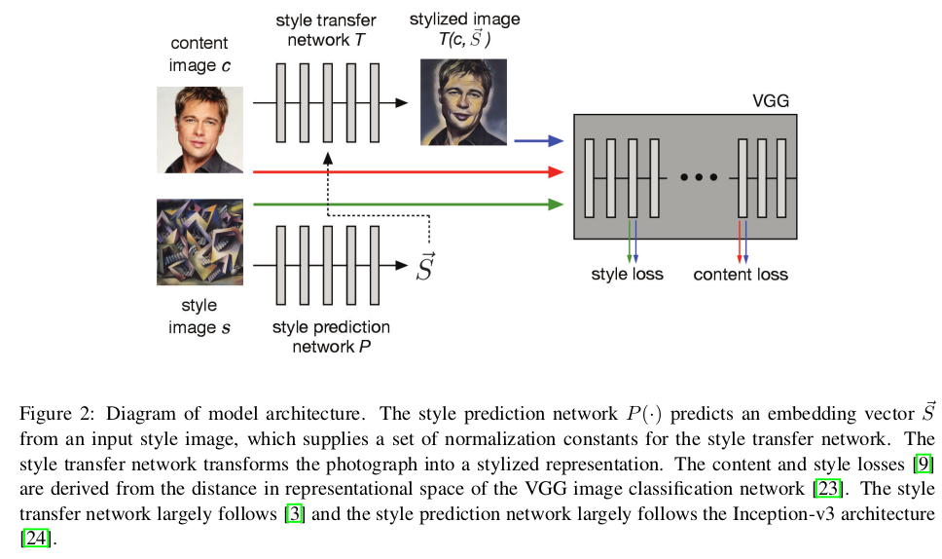
Fast Style Transfer Network
Golnaz Ghiasi et. al.
@Google Brain

Slide 6

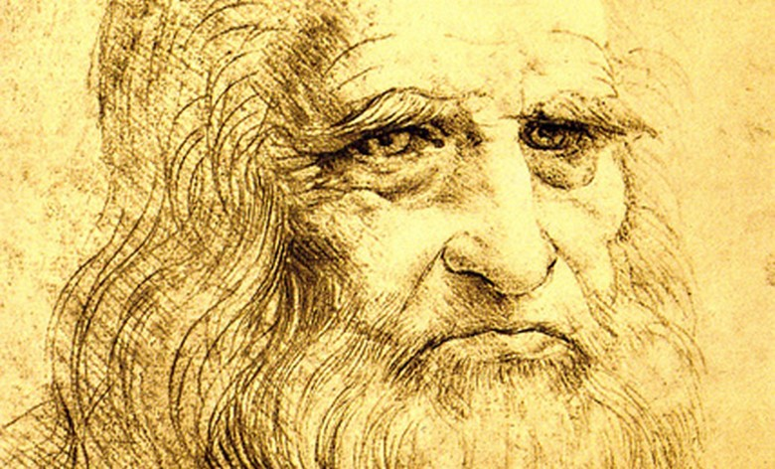
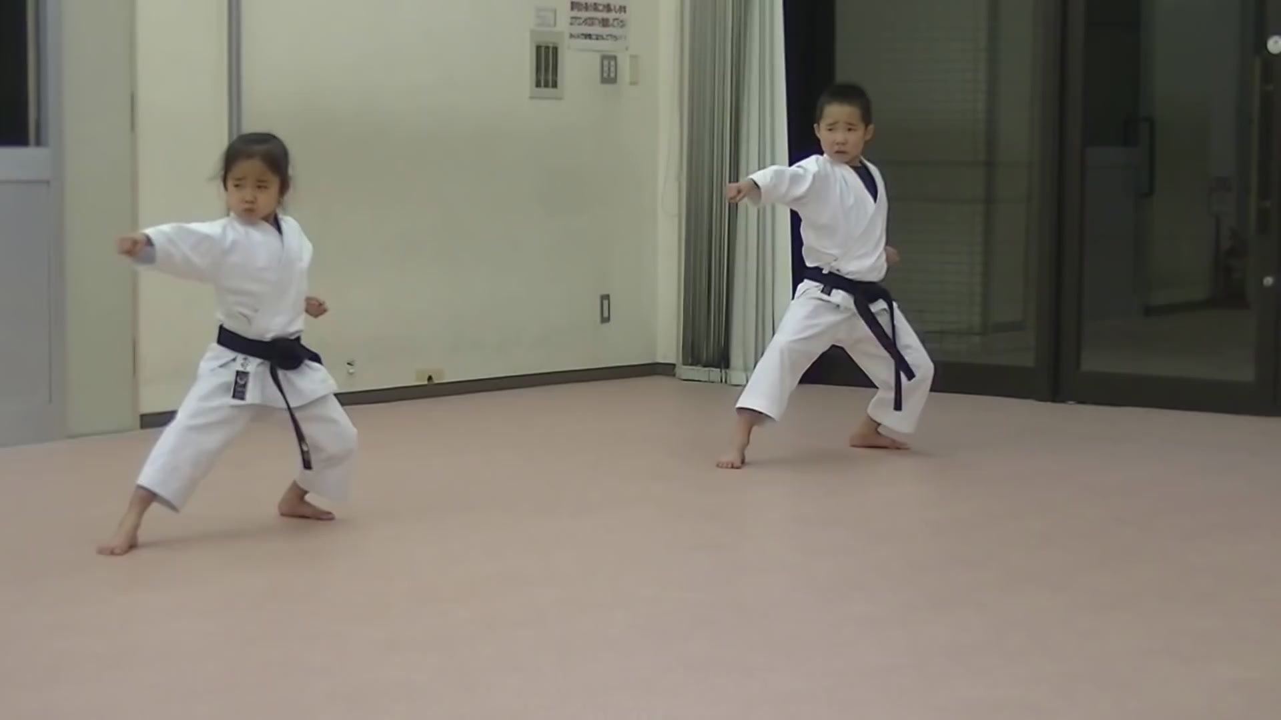
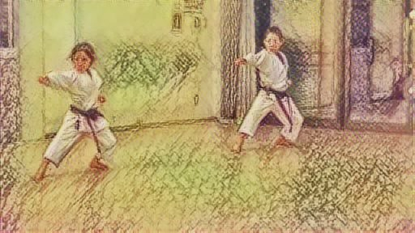
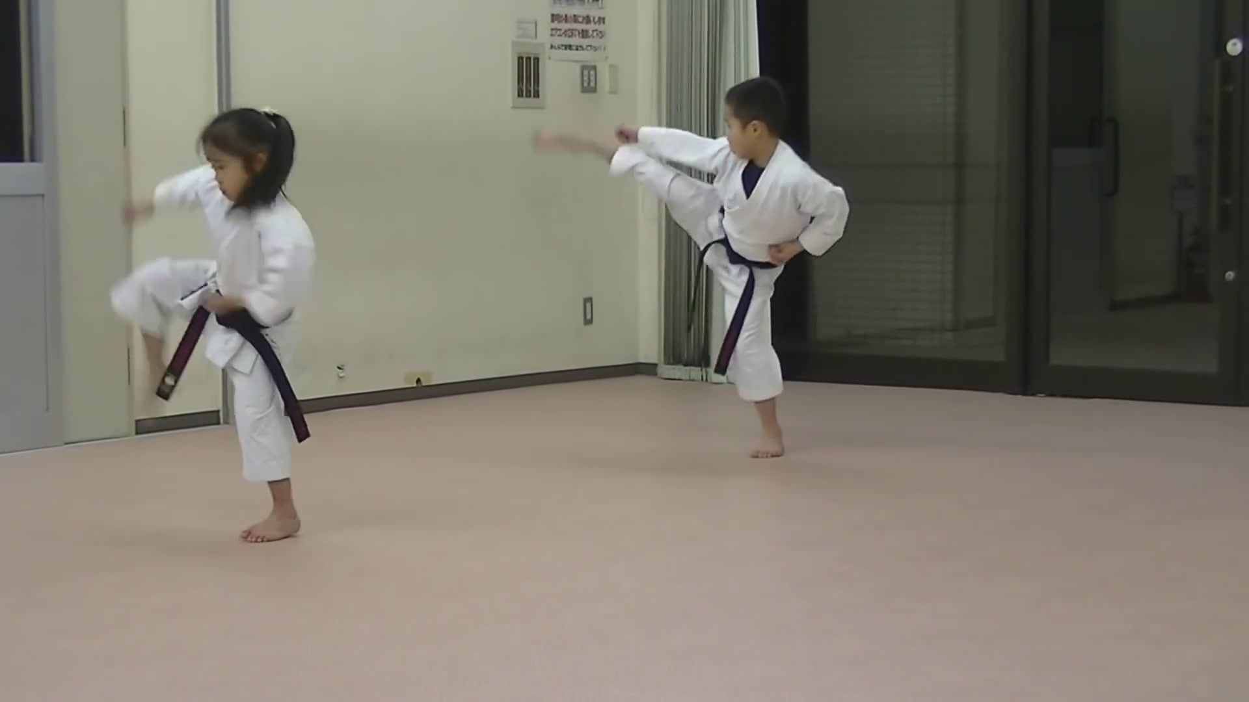
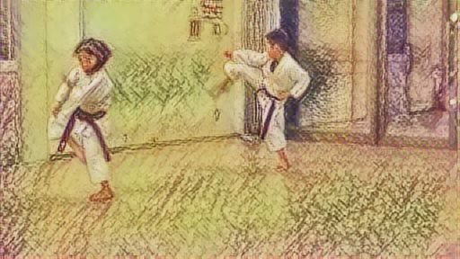
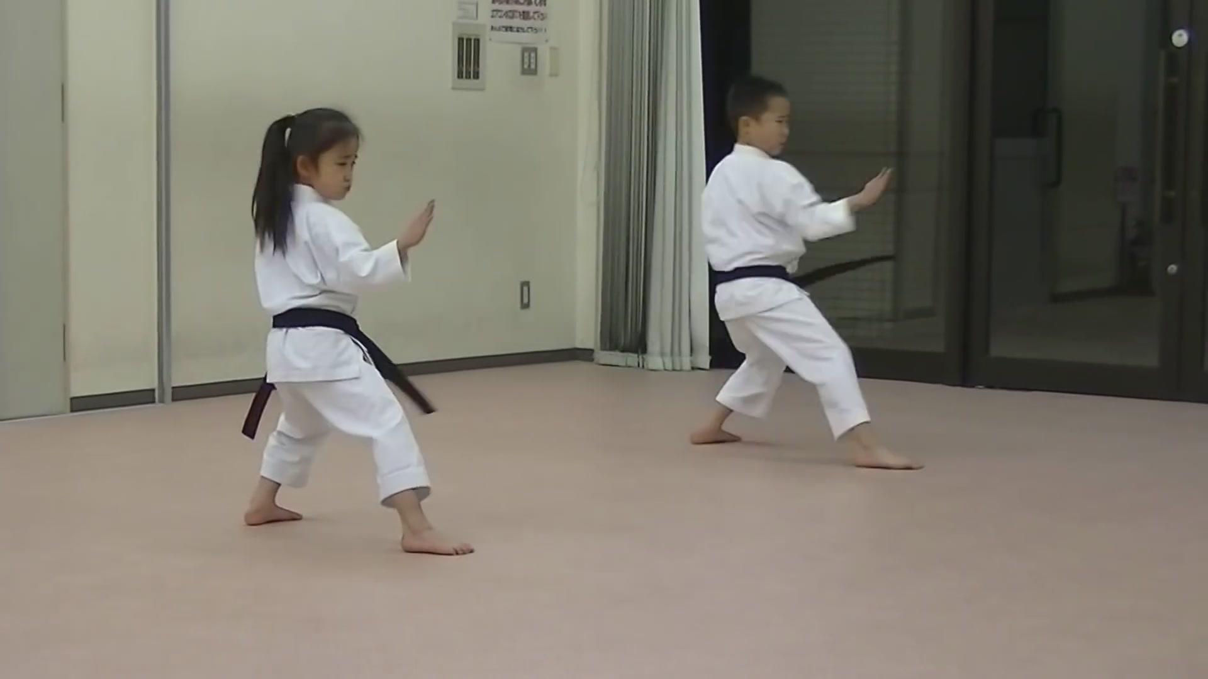
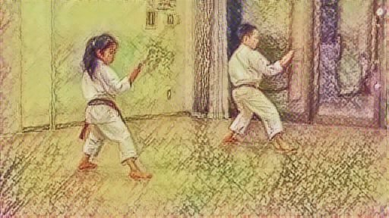
Style Transfer for Videos Workflow
style
Fast Style Transfer
Network
Golnaz Ghiasi et. al.
@Google Brain
Implemented as tensorflow_hub module
Extract images from mp4
Compile images into mp4

Slide 7

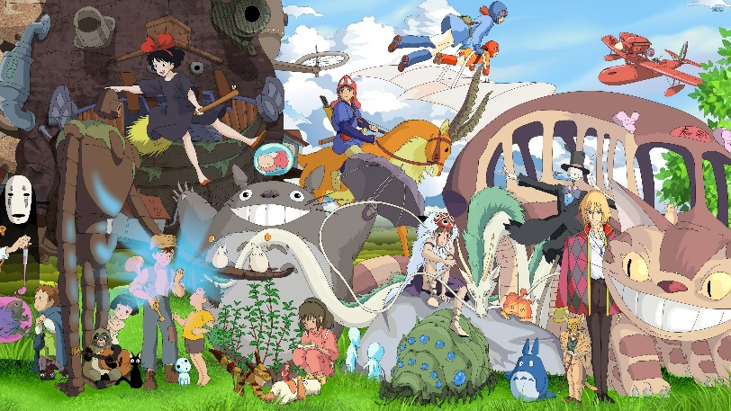
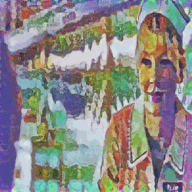
Example
Content Video
Style Image
Target Video

Slide 8
Technical Details

Slide 9

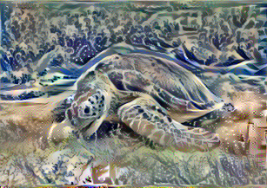
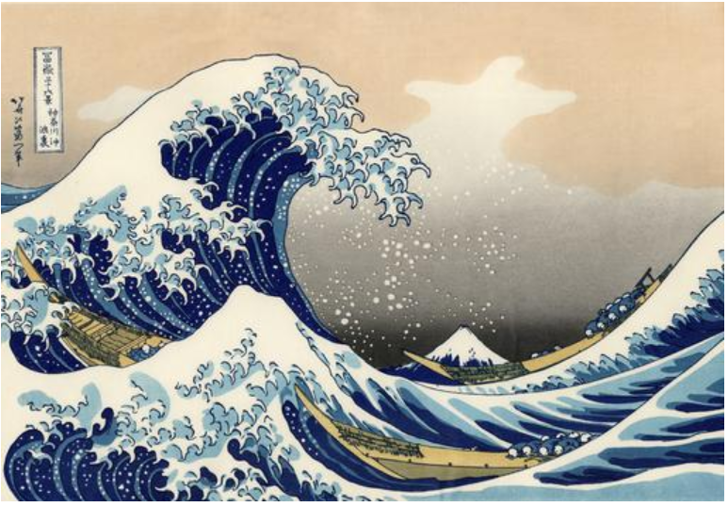
What is Neural Style Transfer?
Created Image = Content Image + Style Image
Content Image
+
=
Created Image
Style Image

Slide 10
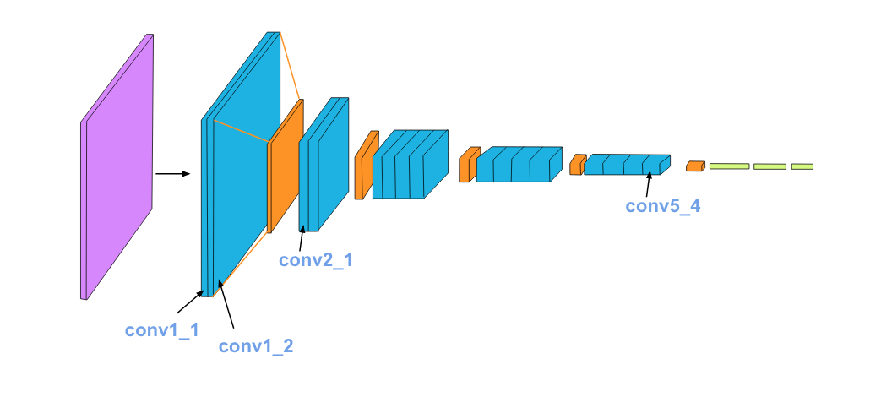
Feature and Content
Feature maps care about texture, color, and curvature.
Content representation cares about content of image.
Capture features from style images; content from content images.
feature maps
content representation
Source:
Udacity, Intro to Deep Learning by Pytorch
Coursera, Convolutional Neural Networks

Slide 11
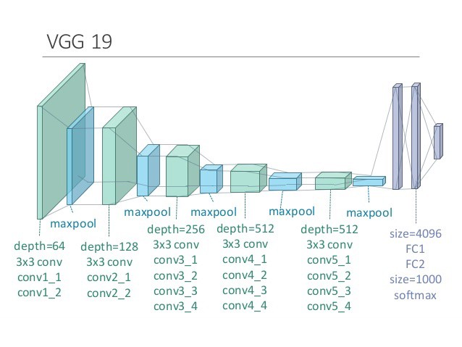
VGG19
For neural style transfer, VGG19 is used as a generator rather than a classifier. (i.e. weights have to be freeze, and top layers have to be removed).
Source: https://towardsdatascience.com/transfer-learning-in-tensorflow-9e4f7eae3bb4

Slide 12
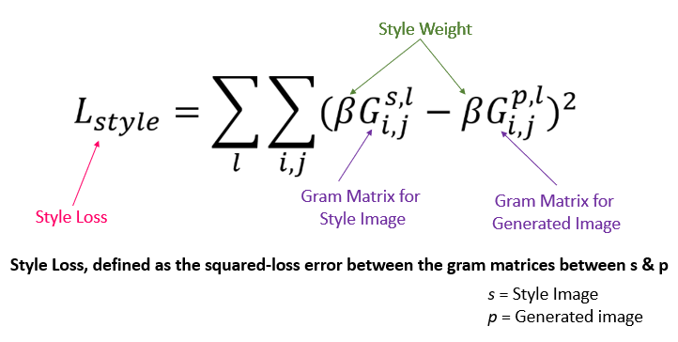
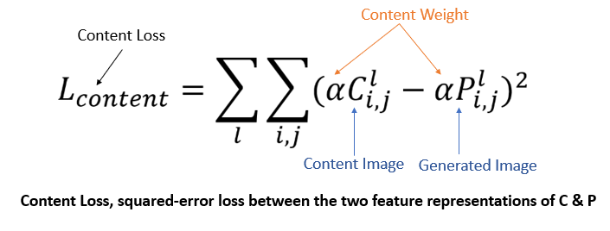
Loss
Content Loss checks how similar the generated image is to the content image.
Style Loss measures how different the generated image, in terms of style features
Total Loss = Content Weight * Content Loss + Style Weight * Style Loss
Source: https://www.pluralsight.com/guides/implementing-artistic-neural-style-transfer-with-tensorflow-2.0

Slide 13
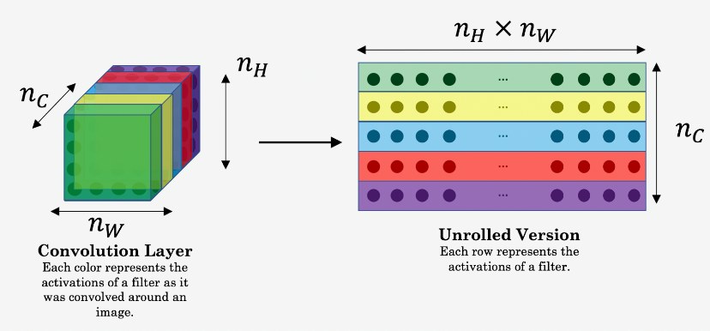
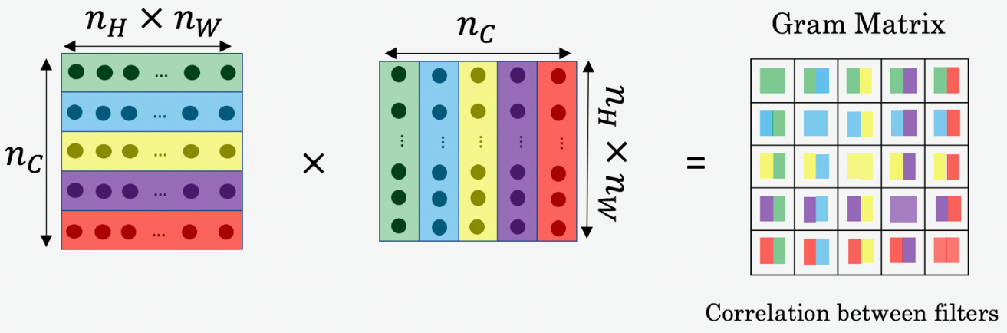
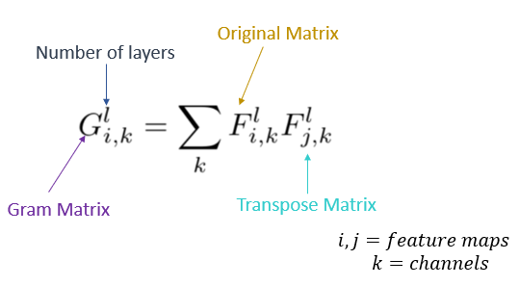
Gram Matrix
The Gram Matrix G is the set of vectors in a matrix of dot products
Gram Matrix is only concerned with whether the stylish features are present in image weights, textures, and shapes. features are present in image weights, textures, and shapes.
Source: https://www.pluralsight.com/guides/implementing-artistic-neural-style-transfer-with-tensorflow-2.0

Slide 14
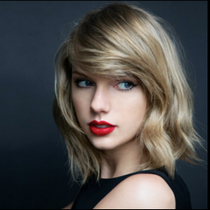
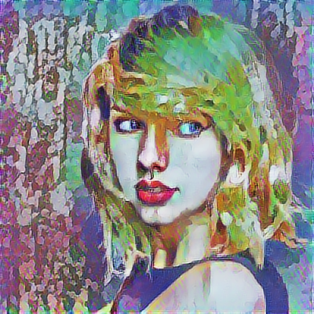

Fast Neural Style Transfer
Example
Content Image
Generated Image
Style Image

